Slide 1

Binary Classification for the Marketing Campine
Presented By
Pradeep Chathuranga

Slide 2
About Project
This project totally based on supervise binary classification of machine learning
The data is related with direct marketing campaigns of a Portuguese banking institution. The classification goal is to predict if the client will subscribe a term deposit
Reference:- https://archive.ics.uci.edu/ml/datasets/Bank+Marketing

Slide 3
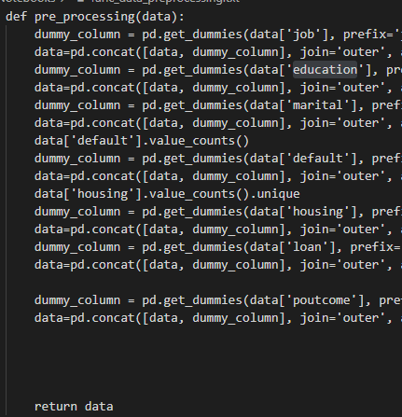
Coding Synopsis
Data Pre-Processing
This Function will be converted categorical variable to binary distribution via ‘One Hot Encoding’ Mechanism

Slide 4


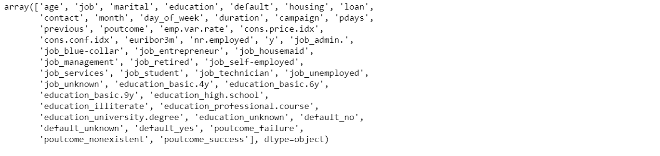
Coding Synopsis
Independent Variable
Dependent Variable
Train Test Split

Slide 5

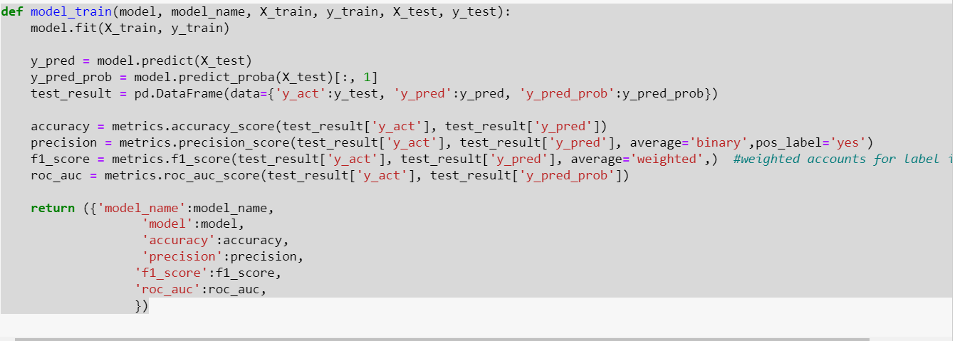
Coding Synopsis
Model Selection
Common Function,

Slide 6

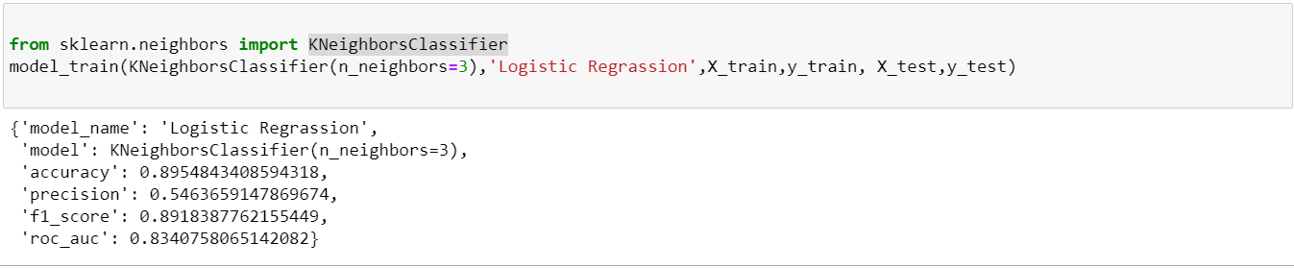
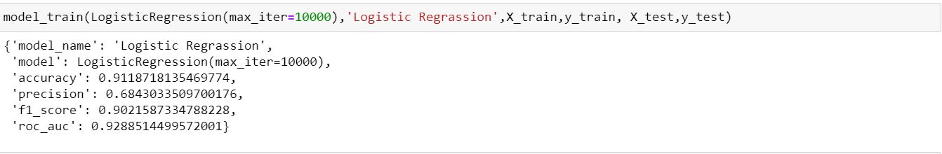
Coding Synopsis
Logistic Regression
KNeighborsClassifier

Slide 7
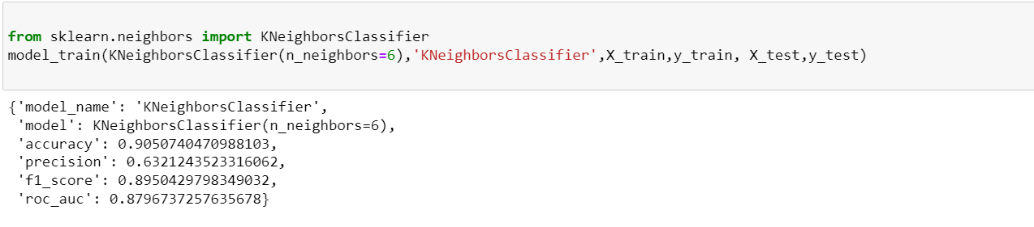
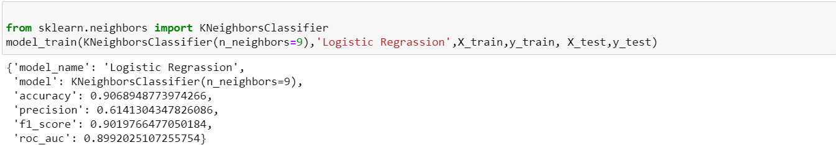
Coding Synopsis
KNeighborsClassifier

Slide 8

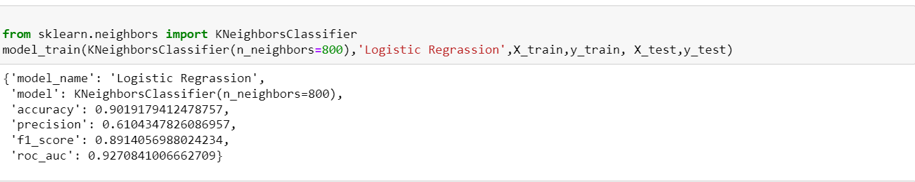
Coding Synopsis
KNeighborsClassifier

Slide 9



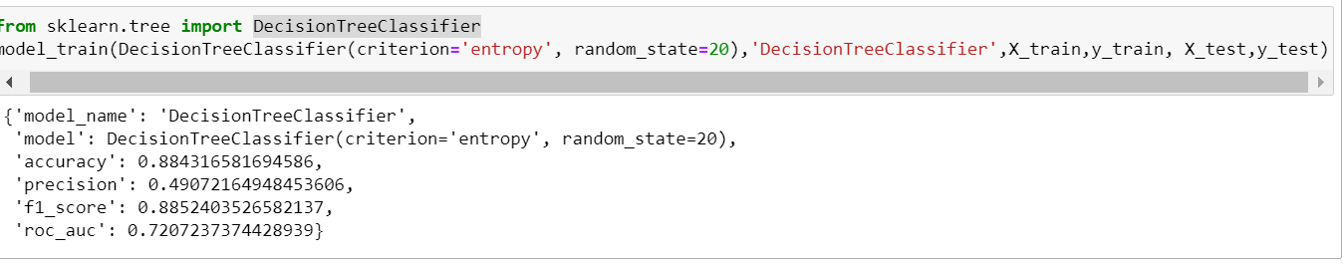
Coding Synopsis
DecisionTreeClassifier
Consultation:- Logistic Regression will be best Algorithem

Slide 10

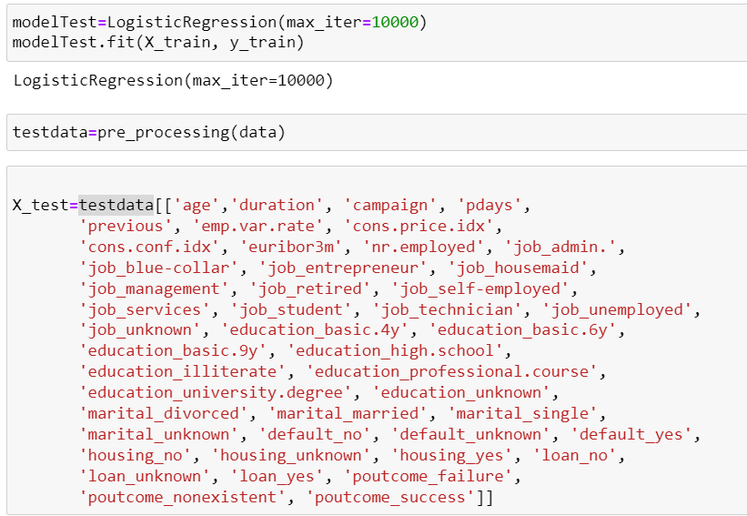
Testing

Slide 11
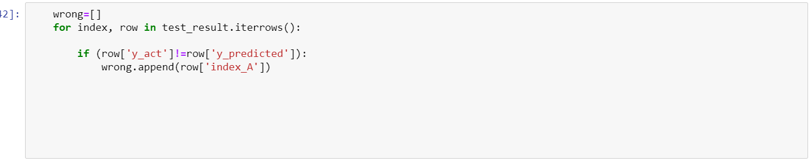
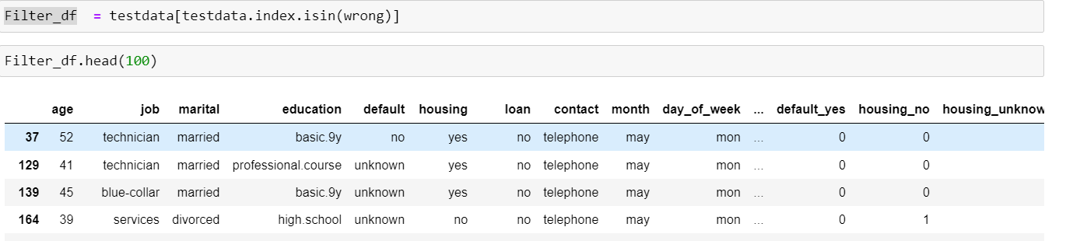
Testing

Slide 12
THANK YOU..

